Slide 1
Imperfect Competition: Monopoly, Oligopoly and Monopolistic Competition
Topics 9-10

Slide 2
Market Structures
Three important characteristics of market in structures:
Number of firms
Degree of product differentiation
Ease of entry and exit.

Slide 3
Types of Market Structure
Number of Firms?
Many
firms
Type of Products?
One
Few
Differentiated
Identical
firm
firms
products
products
Monopolistic
Perfect
Monopoly
Oligopoly
Competition
Competition
•
Electricity
•
Toothpaste
•
Wheat
Railways
•
Crude oil
•
Movies
•
Milk

Slide 4
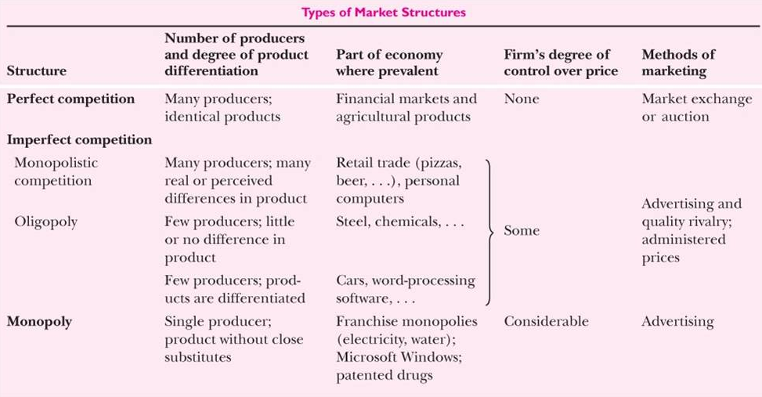
Source: Samuelson, Economics, 19th Edition
11/03/2016

Slide 5
Imperfect Competition
Imperfect Competition prevails in an industry when the firms belonging to this industry can exercise some control over price of the output which they sell.
It does not mean absolute control over the price and the absence of rivals except in the case of monopoly.

Slide 6
Sources of Imperfect Competition:
1) Costs and market imperfections
If economies of scale exist, large firms have an advantage over the small firms. In such a situation, AC will be declining till a large fraction of industry output is produced.
2) Barriers to entry
Legal restriction
Imposed by govt. such as patents to innovator
Entry restriction such as franchise monopolies to public sector undertakings.
Import restrictions.
High Costs of Entry: It is not possible to have a large number of producers selling aircraft, quality cars, software products, electricity, etc., as these need huge investments.
Advertising and product differentiation
3) Ownership of a key inputs.
E.g., DeBeers owns most of the world’s diamond mines

Slide 7
MONOPOLY:
One seller and many buyers, A monopoly is a firm that is the sole seller of a product without close substitutes.
Difficult to enter the markets due to barriers to entry.
Natural monopolies due to declining costs
Artificial monopolies: Legal and government policy induced.
The key difference: A monopoly firm has market power, the ability to influence the market price of the product it sells. A competitive firm has no market power.

Slide 8
Natural monopoly: a single firm can produce the entire market Q at lower AC than could several firms.
Example: 1000 homes need electricity.
AC is lower if one firm services all 1000 homes than if two firms each service 500 homes.
Electricity
Cost per unit of electricity
Economies of scale due to huge FC
Rs 80
Rs 50
AC
Q
500
1000
Notes:
The horizontal axis of the graph measures number of homes provided electricity. The vertical axis measures the average total cost of providing electricity per home.

Slide 9
Monopoly vs. Competition: Demand Curves
In a competitive market, the market demand curve slopes downward.
but the demand curve for any individual firm’s product is horizontal at the market price.
The firm can increase Q without lowering P,
so MR = P for the competitive firm.
A competitive firm’s demand curve
P
D
Q
Notes:
A competitive firm is a price-taker, can sell as much as it wants at the market price.
In effect, the competitive firm sells a product for which there are many perfect substitutes, so demand for its product is perfectly elastic; if it raises its price above the market price, demand for its product falls to zero.
The relationship between P and MR is what distinguishes a competitive firm from a monopoly firm, in terms of both firm behavior and welfare implications.

Slide 10
Monopoly vs. Competition: Demand Curves
A monopolist is the only seller, so she faces the downward sloping market demand curve.
To sell a larger Q, the firm must reduce P.
Thus, MR ≠ P.
If P or AR is falling, MR lies below AR.
A monopolist’s demand curve
P= AR, MR
D = AR
MR
Q
Notes:
This slide introduces the notion that MR is not equal to P for the monopolist. The next slide presents an exercise to lead students to see for themselves what this relationship looks like.

Slide 11
Profit-Maximization
Like a competitive firm, a monopolist maximizes profit by producing the quantity where MR = MC (Marginal cost based pricing).
Once the monopolist identifies this quantity, it sets the highest price consumers are willing to pay for that quantity.
It finds this price from the D curve.

Slide 12
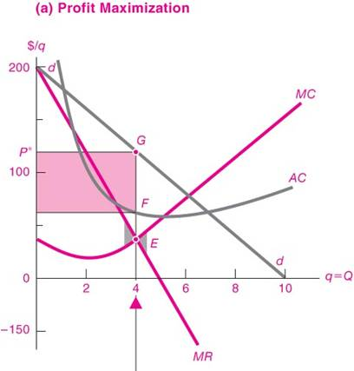
Source: Samuelson, Economics.19ed

Slide 13
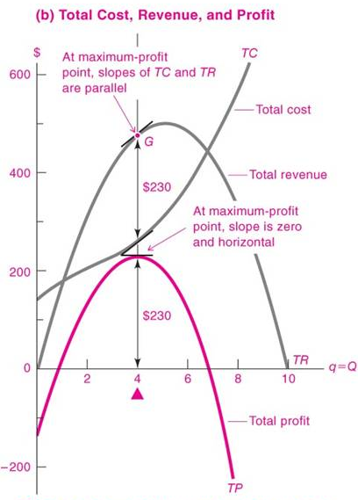
Source: Samuelson, Economics.19ed

Slide 14
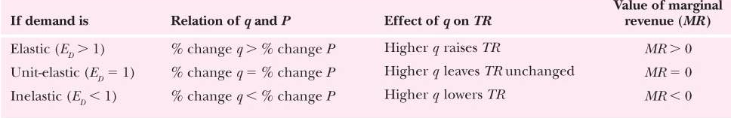
Source: Samuelson, Economics.19ed

Slide 15
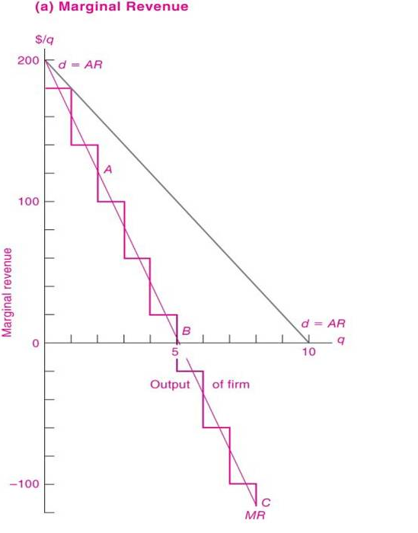
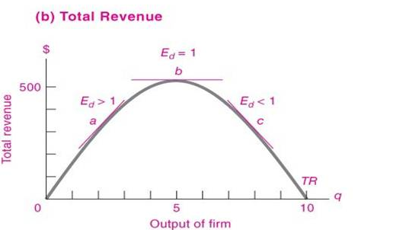
Relationship between Marginal revenue, Total revenue and elasticity of demand
Source: Samuelson, Economics.19ed

Slide 16
Profit maximization problem of a monopolist
TC= 50 + Q²
P = 40 - Q
R= 40Q - Q²
Π= 40Q - Q² - 50 - Q²
dΠ/dQ = 40 -2Q -2Q
Π max if (i) dΠ/dQ = 0; and (ii) d²Π/dQ ² < 0
MC= 2Q and MR = 40 -2Q
(i) dΠ/dQ = 0 in this case when 4Q = 40:
Profit maxima : Q=10; P = 30
d²Π/dQ ² ⁼ - 4 and < 0 and hence (ii) is also satisfied.
When tangents to Total Revenue and Total Cost functions are parallel the profit function attains maxima.

Slide 17
Sales maximization: Goal of the firm
R= 40Q - Q²
(i) dR/DQ = 0
40 – 2Q = 0
Q = 20
P = 20
(ii) d²R/DQ² < 0
-2 < 0
Note: Output is higher and price lower as compared to profit maximization

Slide 18
Concentration Ratio
Percentage of total industry output/shipment, which is accounted for by the topmost firms. Concentration ratio zero for perfect competition and 1 for monopoly.

Slide 19
Imperfect Competition prevails in an industry when the firms belonging to this industry can exercise some control over price of the output which they sell.
It does not mean absolute control over the price and the absence of rivals except in the case of monopoly.

Slide 20
A monopoly’s revenue
Following data shows demand schedule for a monopolist.
Fill in the missing spaces of the table.
What is the relation between P and AR? Between P and MR?
Q | P | TR | AR | MR
0 | 4.50
1 | 4.00
2 | 3.50
3 | 3.00
4 | 2.50
5 | 2.00
6 | 1.50
20

Slide 21
The Welfare Cost of Monopoly
In a competitive market equilibrium, P = MC = MR and total surplus is maximized.
In the monopoly equilibrium, P > (MR = MC)
The value to buyers of an additional unit (P) exceeds the cost of the resources needed to produce that unit (i.e., MC).
The monopoly Q (P) is lower than in a competitive equilibrium
The monopoly P is higher than in a competitive equilibrium

Slide 22
Government Intervention and Imperfections in Market Structure
Increasing competition with anti-monopoly laws
Regulation
Public ownership
Example: Indian Railways
Problem: Public ownership is usually less efficient since no profit motive to minimize costs
Doing nothing
The foregoing policies all have drawbacks, so the best policy may be no policy.

Slide 23
Public Policy Toward Monopolies
Failure of Market Economy | Government Intervention | Policy Action
Inefficiency i) Monopoly | Encourage competition | Restriction on monopolies and restrictive trade practices

Slide 24
Price Discrimination
Price discrimination is the business practice of selling the same good at different prices to different buyers.
The characteristic used in price discrimination is willingness to pay (WTP):
A firm can increase profit by charging a higher price to buyers with higher WTP.
Perfect Price Discrimination: Charging each customer a price according to his/her willingness to pay

Slide 25
Price Discrimination in the Real World
In the real world, perfect price discrimination is not possible:
no firm knows every buyer’s WTP
buyers do not announce it to sellers
So, firms divide customers into groups based on some observable trait that is likely related to WTP, such as age.

Slide 26
Examples of Price Discrimination
Movie tickets Discounts for vodafone customers!
Conference registrations Discounts for early registration.
Discount coupons: Pizza Hut discounts on the next pizza ordered
Need-based financial aid: Merit and means scholarships, lower interest rates for agricultural and export sectors (priority sectors)
Quantity discounts: Group discounts in a museum

Slide 27
Monopolistic Competition
Imperfect competition refers to those market structures that fall between perfect competition and pure monopoly.

Slide 28
Monopolistic Competition
Markets that have some features of competition and some features of monopoly.
Attributes of monopolistic competition:
Many sellers
Product differentiation
Free entry and exit

Slide 29
Monopolistic Competition
Product Differentiation
Each firm produces a product that is at least slightly different from those of other firms.
Rather than being a price taker, each firm faces a downward-sloping demand curve.

Slide 30
Monopolistic Competition
Free Entry or Exit
Firms can enter or exit the market without restriction.
The number of firms in the market adjusts until economic profits are zero.

Slide 31
COMPETITION WITH DIFFERENTIATED PRODUCTS
The Monopolistically Competitive Firm in the Short Run
Short-run economic profits encourage new firms to enter the market. This:
Increases the number of products offered.
Reduces demand faced by firms already in the market.
Incumbent firms’ demand curves shift to the left.
Demand for the incumbent firms’ products fall, and their profits decline.

Slide 32
Monopolistic Competition in the Short Run
(a) Firm Makes Economic or supernormal Profit
Price
MC
ATC
Price
Average
total cost
Demand
Profit
MR
0
Profit-
Quantity
maximizing
quantity

Slide 33
Monopolistic Competitors in the Short Run
(b) Firm Makes Subnormal profits or Losses
Price
MC
ATC
Losses
Average
total cost
Price
MR
Demand
0
Loss-
Quantity
minimizing
quantity

Slide 34
The Monopolistically Competitive Firm in the Short Run
Short-run economic profits (losses) encourage firms to enter (exit) the market.
Increases (Decreases) the number of products offered.
Decreases (Increases) demand faced by the remaining firms.
Shifts the remaining firms’ demand curves to the left (right).
Decreases (Increases) the remaining firms’ profits.
Firms will enter and exit until the firms are making exactly zero economic profits.

Slide 35
A Monopolistic Competitor in the Long Run
Price
MC
AC
The demand curve is tangent to the AC curve.
P
=
AC
And this tangency lies vertically above the intersection of MR and MC.
Demand
MR
0
Profit-maximizing
Quantity
quantity

Slide 36
Monopolistic versus Perfect Competition
There are two noteworthy differences between monopolistic and perfect competition:
Excess capacity
Markup over marginal cost

Slide 37
Monopolistic versus Perfect Competition
(a) Monopolistically Competitive Firm
(b) Perfectly Competitive Firm
Price
Price
MC
ATC
MC
ATC
P
P
=
MC
P
=
MR
(demand
curve)
MR
Demand
0
Quantity
Efficient
Quantity
0
Quantity produced =
Quantity
produced
scale
Efficient scale

Slide 38
The Long-Run Equilibrium
Two Characteristics
As in a monopoly, price exceeds marginal cost.
Profit maximization requires marginal revenue to equal marginal cost.
The downward-sloping demand curve makes marginal revenue less than price.
As in a competitive market, price equals average total cost.
Free entry and exit drive economic profit to zero.

Slide 39
ADVERTISING
When firms sell differentiated products and charge prices above marginal cost, each firm has an incentive to advertise in order to attract more buyers to its particular product.

Slide 40
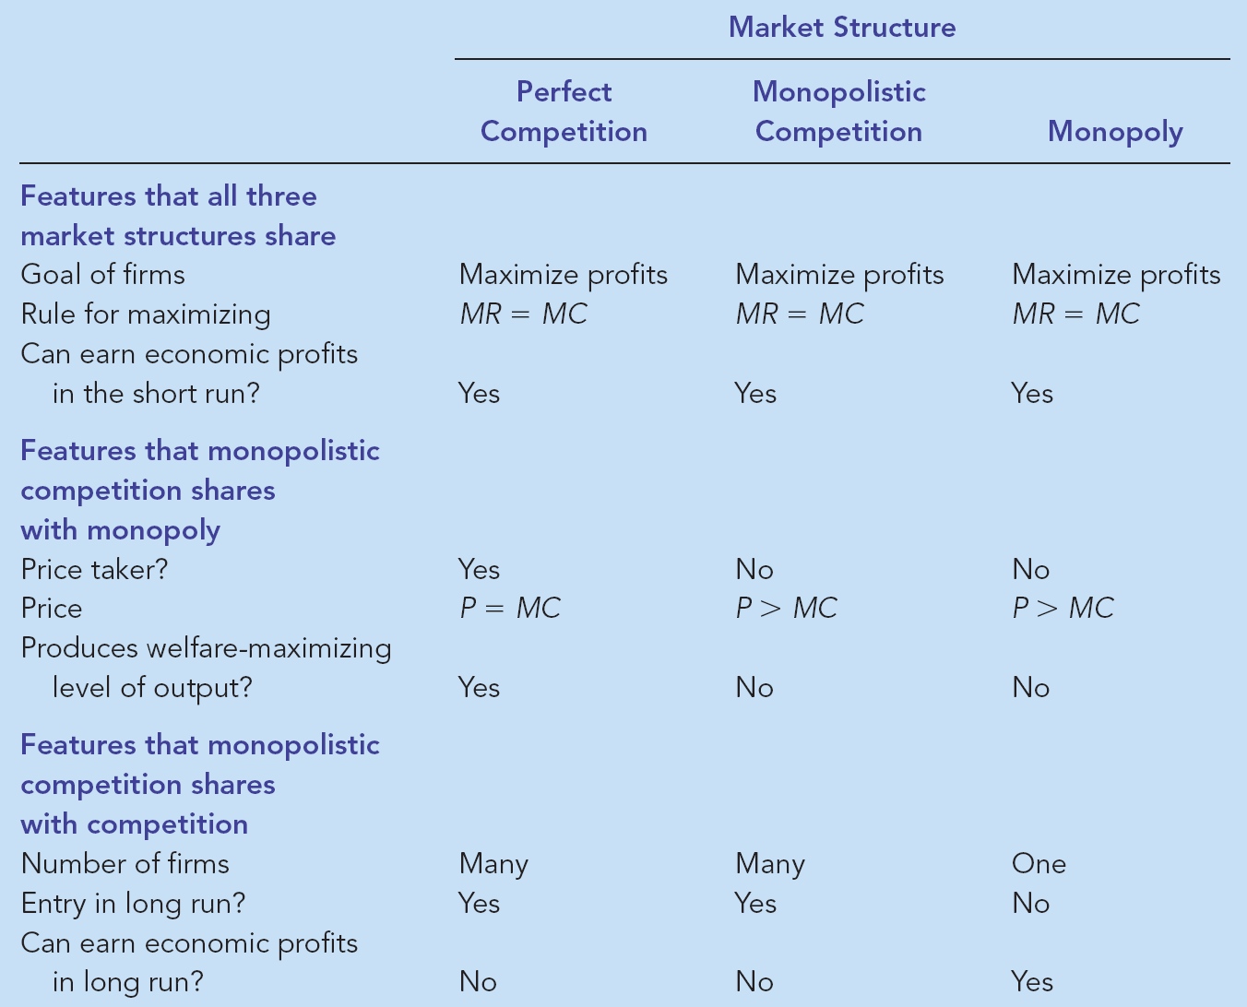
Monopolistic Competition: Between Perfect Competition and Monopoly

Slide 41
Oligopoly
Only a few sellers, each offering a similar or identical product to the others.
Because of a few sellers, the key feature of oligopoly is the tension between cooperation and self-interest.
Characteristics of an Oligopoly Market
A few sellers offering similar or identical products
Interdependent firms
Best off cooperating and acting like a monopolist by producing a small quantity of output and charging a price above marginal cost
A duopoly is an oligopoly with only two members. It is the simplest type of oligopoly.

Slide 42

Market power:
degree of control that a single firm or a small number of firms (top-four/top-eight/top-ten) have over the price and production decisions in an industry.
One of the measures of market powers is the Concentration ratio (percentage of total industry output/shipment which is accounted for by the topmost firms).
Concentration ratio zero for perfect competition and 1 for monopoly.
Degree of Monopoly power is also measured by how much a firm can charge to the consumers over and above its marginal cost, as given in the formula below. It is also inversely related to the price elasticity of demand.

Slide 43
Competition, Monopolies, and Cartels
The duopolists/oligopolists may agree on a monopoly outcome.
Collusion
An agreement among firms in a market about quantities to produce or prices to charge.
Cartel
A group of firms acting in unison.
Although oligopolists would like to form cartels and earn monopoly profits, often that is not possible. Antitrust laws prohibit explicit agreements among oligopolists as a matter of public policy.

Slide 44
Oligopoly
few firms
either homogeneous or differentiated products
interdependence of firms - policies of one firm affect the other firms
substantial barriers to entry
E.G. Mobile service providers, power companies

Slide 45
Collusion and Competition
Oligopoly firms may collude (act as a monopoly) and earn positive profits.
OR
Oligopolists may compete with each other and drive prices down to where profits are zero.

Slide 46
While it pays for firms to collude, in order to earn positive profits, it also pays to cheat on the collusive agreement. If one firm cuts its price to slightly below the others, it could gain a lot of business.
If everyone cheats on the agreement, however, the agreement falls apart.

Slide 47
Collusive agreements less likely to succeed when
secret price cuts are difficult and costly to detect. (Quality changes are difficult to monitor.)
market conditions are unstable. (Differences in expectations make it difficult to reach an agreement.)
vigorous antitrust action increases the cost of collusion.

Slide 48
Some oligopolistic markets operate in a situation of price leadership.
A single firm sets industry price and the remaining firms charge the same price as the leader.

Slide 49
Sweezy’s kinked demand curve model of oligopoly
Assumptions:
1. If a firm raises prices, other firms won’t follow and the firm loses a lot of business.
So demand is very responsive or elastic to price increases.
2. If a firm lowers prices, other firms follow and the firm doesn’t gain much business.
So demand is fairly unresponsive or inelastic to price decreases.

Slide 50
The Kinked Demand Curve
Rs
P*
D
Q*
quantity

Slide 51
MR Curve for the top part of the Demand Curve
Rs
D
P*
MR
Q*
quantity

Slide 52
Drawing MR Curve for the bottom part of the Demand Curve
Rs
P*
MR
D
Q*
quantity

Slide 53
MR Curve for the bottom part of the Demand Curve
Rs
P*
MR
D
Q*
quantity

Slide 54
The Kinked Demand Curve and the MR Curve
Rs
P*
MR
D
Q*
quantity

Slide 55
The MC curve intersects the MR curve in the vertical segment.
$
MC
P*
MR
D
Q*
quantity

Slide 56
If costs shift up slightly, but MC still intersects MR in the vertical segment, there will be no
change in price. This price rigidity/stickiness is seen in real world oligopoly markets.
Rs
MC’
MC
P*
D
Q*
MR
quantity

Slide 57
The AC curve can be added to the graph. To show positive profits, part of A C curve must lie under part of the demand curve.
Rs
MC
A C
P*
D
Q*
MR
quantity

Slide 58
The Equilibrium for an Oligopoly
When firms in an oligopoly individually choose production to maximize profit, they produce quantity of output greater than the level produced by monopoly and less than the level produced by competition.
The oligopoly price is less than the monopoly price but greater than the competitive price (which equals marginal cost).

Slide 59
Equilibrium for an Oligopoly
Summary
Possible outcome if oligopoly firms pursue their own self-interests:
Joint output is greater than the monopoly quantity but less than the competitive industry quantity.
Market prices are lower than monopoly price but greater than competitive price.
Total profits are less than the monopoly profit.

Slide 60
Controversies over Policy to regulate imperfections in the market
Resale Price Maintenance (or fair trade)
occurs when suppliers (like wholesalers) require retailers to charge a specific amount
Predatory Pricing
occurs when a large firm begins to cut the price of its product(s) with the intent of driving its competitor(s) out of the market
Tying
when a firm offers two (or more) of its products together at a single price, rather than separately

